Slide 1
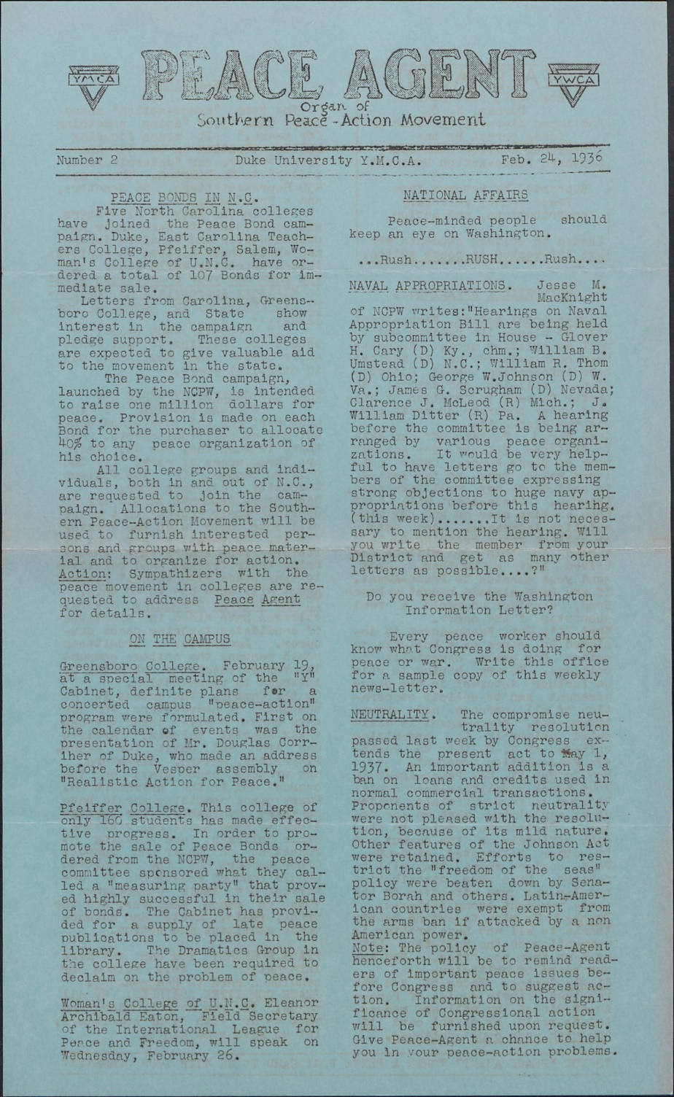
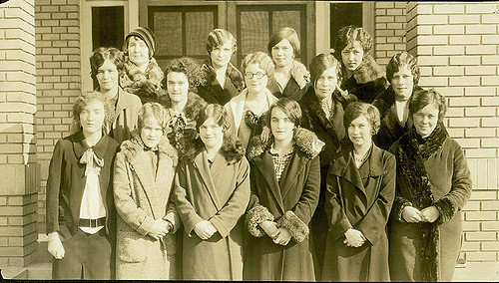
Hidden Student Activism Made Visible:
A Collaborative Approach to Librarian Learning
By Arianne Hartsell-Gundy, Kelley Lawton, and Hannah Rozear
Duke University
Groups
We formed small groups to focus on different tasks and learn new skills. Groups were a mixture of experts and novices.
Workflow
Lessons Learned
Brainstorming and Goal Setting
Deadlines are your friend
Archival research is time consuming
How to balance our “day jobs” with this project
Many questions to answer (where to store files, where should website live, etc.)
Managing with no budget
Take advantage of in-house expertise
What are the project goals?
What do we want to achieve as a group and as individuals?
What should the project focus be based on available resources, resident experts, and possible student and faculty interest?
Text Analysis Team
AntConc
NVivo
Abbyy FineReader
Clean OCR
Website Team
Drupal
Design
Hosting
Sustainability
Exploration and Research
Small teams established to explore the feasibility of suggested topics: Duke architecture, unionization, instructor syllabi, and student activism
Presentations on the viability of the topics given; student activism selected
Research Team established to spearhead the archival research and to help narrow the timeframe; text-mining subgroup created to analyze large sets of text (e.g., the student newspaper and yearbook)
Documentation Team established to record the lifecycle of the project
Research Team
Archival research
Digitization
Organization of files
Storage
Timeline Team
Timeline JS
Digitization
Dealing with images
Design
Designing and Implementing
Website and Timeline Teams established
Teams spearheaded decisions on project platform (Drupal) and timeline software (Timeline JS)
Research Team completed work and conveyed findings to the Timeline Team
Website and Timeline Teams currently working on a prototype site to present to the entire digital project group
Student Activism at Duke
League of Women Voters, 1927, Duke University Archives
https://www.flickr.com/photos/dukeyearlook/2108912472/
Courtney Sharpe Ward Papers, UNC-Chapel Hill,
http://finding-aids.lib.unc.edu/05687/
Defining Activism: We had to rework our definition of what student activism looked like at Duke during this time period. We defined activism broadly to include instances where students organized with one another, looked at issues beyond the campus walls, and engaged in political and social activities that challenged the status quo on campus.
Historic Scope: The first mass student movements began in 1929 and escalated on US college campuses through the start of WWII. While Duke University was not at the forefront of these movements, our digital project team wanted to hone in on the 1930s-1940s and dig deep in the archives to uncover hidden currents of student activism on our campus.
Themes & Groups: The currents, or themes, that emerged in our research were ones relating to: workers’ rights, gender equality, racial equality, peace movements, and campus reforms. We organized the project around the groups that were advocating for these issues on campus, which included: the Liberal Club, the League of Women Voters, the American Student Union, Veterans of Future Wars, and the YMCA/YWCAs.

